Slide 1
Computational deep phenotyping of individuals with likely genetic epilepsy syndromes
Alina Ivaniuk, Christian Bosselmann, Dennis Lal

Slide 2

Computational phenotyping can help us rethink retrospective research
PAST & PRESENT:
Individual physicians report on patients they see in clinic
Manual chart review to compile data set on clinical features of cohort
Heterogeneous, low-throughput data only usable for few studies
FUTURE:
Utilize natural language processing to identify patients of interest
Limit manual chart review by querying the backend EMR database
Homogeneous pipeline to power automated analysis for different research uses

Slide 3
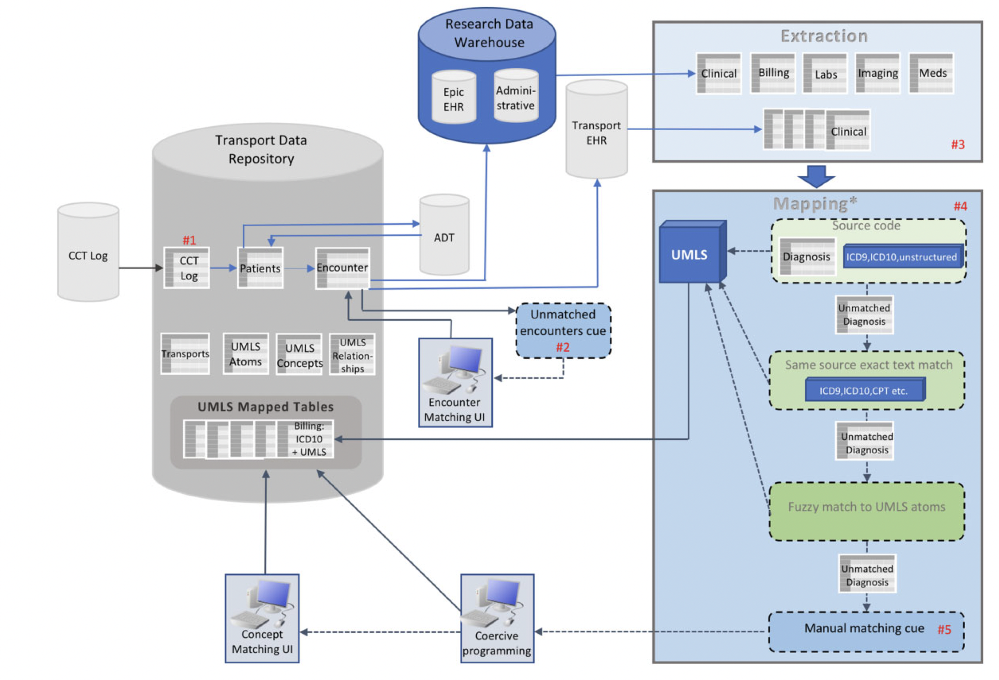
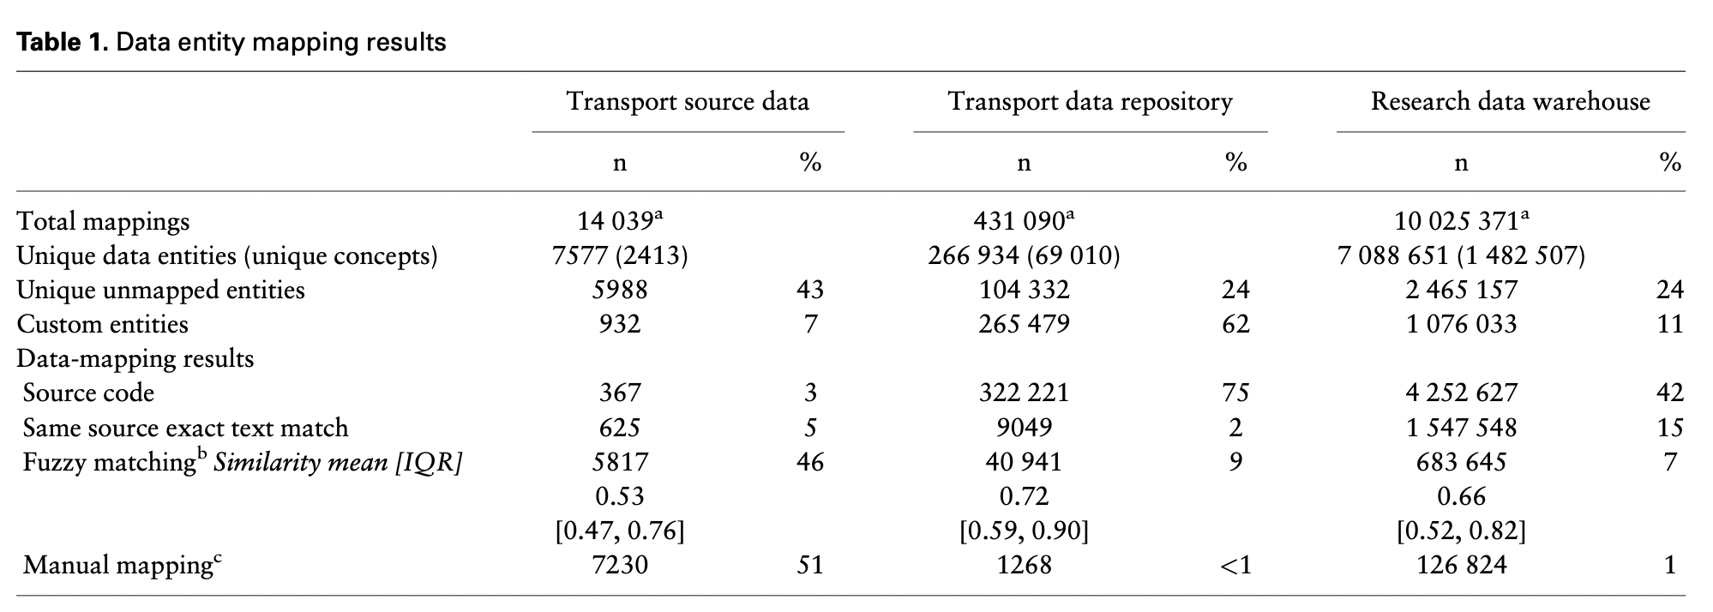
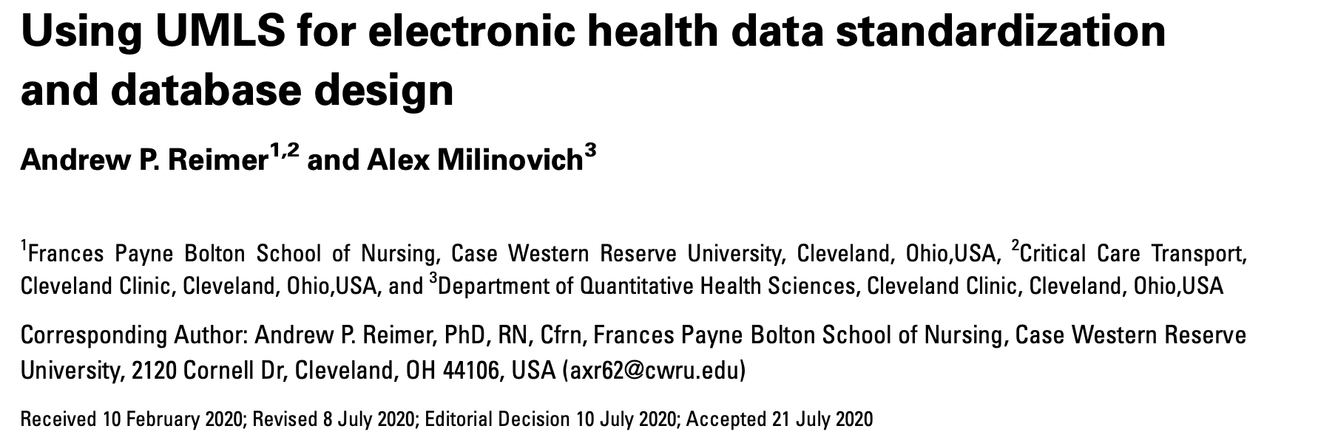
The Cleveland Clinic has state-of-the-art clinical data infrastructure

Slide 4

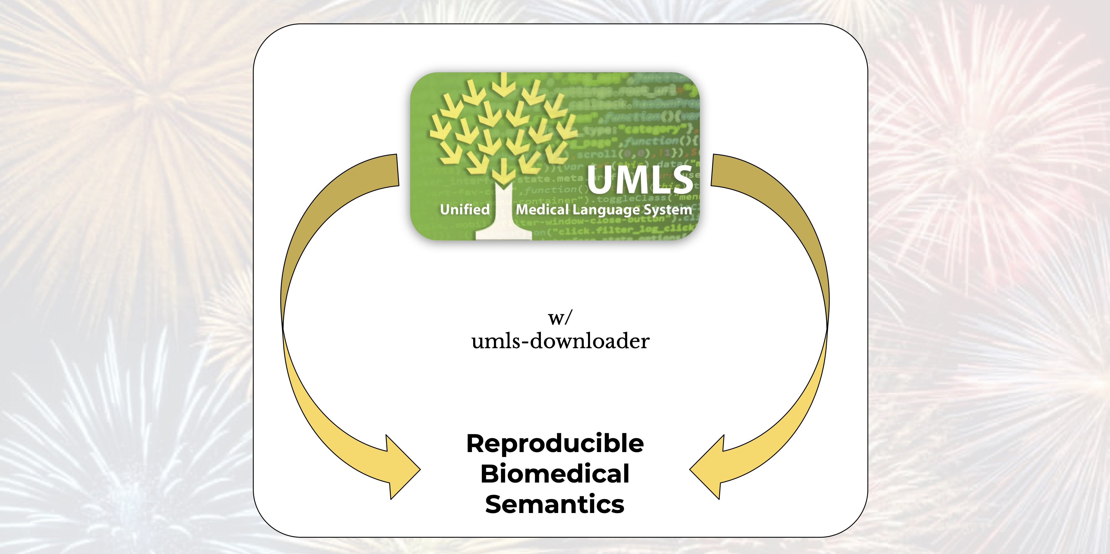
Ontologies can help us harmonize and standardize phenotypic information

Slide 5
Retrospective analysis of genetic epilepsy across >10,000 patient years
Cohort definition
ICD10 G40.x and CPT EEG
Diagnosis at age 0-5 years
ICD matching and NLP algorithm to find (likely) genetic individuals
Statistical approach
Cohort matching, propensity score nearest-neighbour matching (age, sex, ethnicity, and median age), normalization for encounter frequency with downsampling, significance threshold Bonferroni-corrected alpha <0.01
A: Length of follow-up from electronic health record (EHR) for 1671 patients with a total >10,000 patient years of follow-up (mean 6.5, range 0-28). >1,000,000 phenotype annotations with 7192 unique UMLS concepts and 1355 unique HPO terms after propagation.

Slide 6
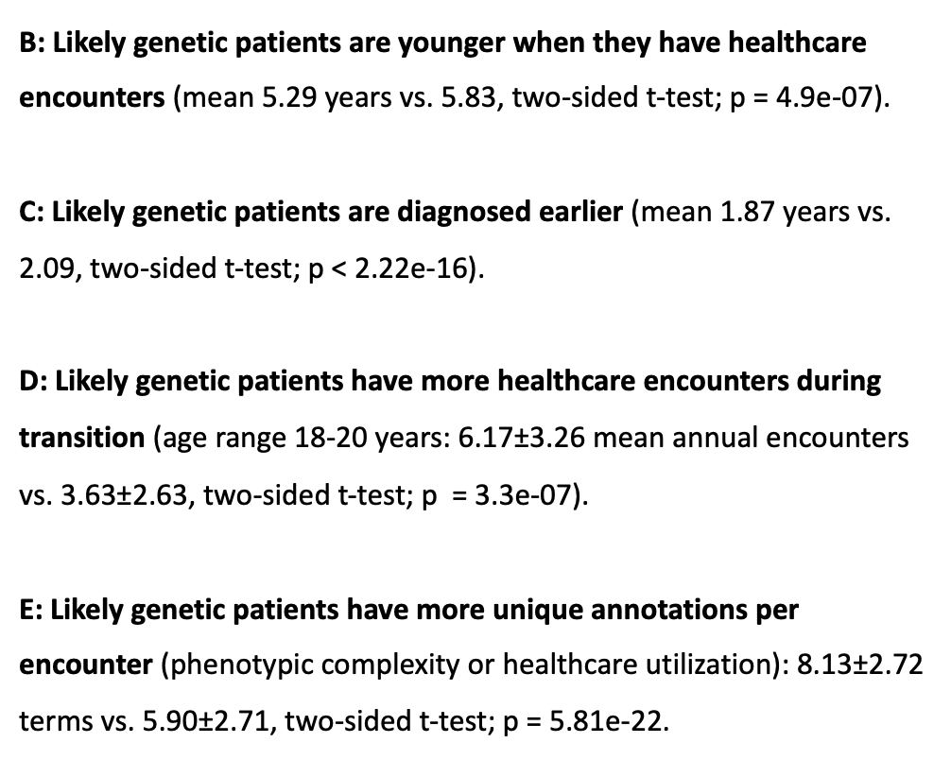
Likely genetic patients have distinct EHR signatures and clinical features
B: Likely genetic patients are younger when they have healthcare encounters (mean 5.29 years vs. 5.83, two-sided t-test; p = 4.9e-07).
C: Likely genetic patients are diagnosed earlier (mean 1.87 years vs. 2.09, two-sided t-test; p < 2.22e-16).
D: Likely genetic patients have more healthcare encounters during transition (age range 18-20 years: 6.17±3.26 mean annual encounters vs. 3.63$\text{±}$2.63, two-sided t-test; p = 3.3e-07).
E: Likely genetic patients have more unique annotations per encounter (phenotypic complexity or healthcare utilization): 8.13$\text{±}$2.72 terms vs. 5.90$\text{±}$2.71, two-sided t-test; p = 5.81e-22.

Slide 7
Likely genetic patients have distinct EHR signatures and clinical features
ICH/SAH is more likely in non-genetic patients (141/8924 vs. 10/13204, p = 1.0e-43)
Genitourinary system abnormalities: OR 1.91 (95% CI: 1.66-2.19)
A: Some clinical features are significantly more common in likely genetic patients. Enrichment plot of term frequency (axes) for likely genetic vs. non-genetic patients. Each dot corresponds to a clinical feature. Dots are colored if they are significant, with larger dots corresponding to lower p-value (Fisher’s exact t-test, p-values adjusted for multiple testing via Bonferroni, alpha 0.05).
B: Likely genetic patients have distinct patterns of high-level clinical features. Forest plot of log Odds Ratio shown for each system-level phenotypic abnormality.

Slide 8
Longitudinal phenotypes can show time-dependent clinical features
C: Some clinical features are time-dependent, and longitudinal phenotyping can make efficient use of EHR data. Dot plot of term significance (p-value, log scale on the y-axis) and patient age. Terms are binned by age ranges and only shown where their significance level is highest. P-values adjusted for multiple testing, threshold shown as dotted line (alpha 0.05).

Slide 9
Likely genetic patients have distinct ASM prescription patterns
Heatmap of 40,000 prescriptions for 1084/1671 patients from our longitudinal cohort. Prescriptions are binned by age (y-axis). Tiles are color-coded and labelled by Odds Ratio. Grayed-out tiles are not significant (adj. P-value >0.05). Missing tiles correspond to insufficient data.
Likely genetic patients are more likely to receive prescriptions for rescue medication, and older children receive more CLP/DZP than LZP.
Likely genetic patients are more likely to receive syndrome-specific ASMs (VGB, RUF) or third-line and broad-spectrum ASMs (TPM, PHT).

